Slide 1
Removing Pyrene from contaminated soil
By Daniel Ledesma

Slide 2
The Dataset (Unbalanced Design with One Factor)
Plant Species | 1 | 2 | 3 | 4 | 5 | 6 | 7 | 8
A.gerardii | 2.44 | 2.81 | 3.62 | 4.16 | 8.15 | 5.23 | 12.09 | 7.75
P. coloratum | 3.8 | 3.58 | 5.63 | 5.31 | 7.25 | 12.75 | 17.25 | 18.91
M. officionalis | 3.10 | 1.87 | 4.59 | 2.77 | 9.15 | 28.37 | 13.57 | 42.09
T. aestivum | 6.51 | 9.65 | 10.03
No Plant | 40.34 | 59.85 | 61.5 | 40.78 | 60.50 | 62.98

Slide 3


The Fixed-Effects Model
The model to the test the ability of different plant species to remediate soils contaminated with pyrene is:
$y_{ij}=μ+τ_{i}+e_{ij}$
where $μ$= overall mean of pyrene concentration common to all plant species
$τ_{i}$= the effect of the plant species
$e_{ij}$= the random error

Slide 4
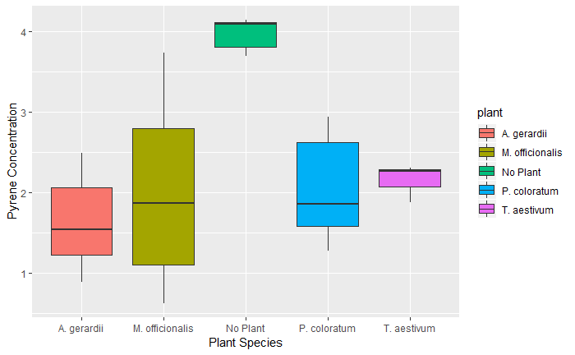
Graphical Observations
No Plant grown in pot has the highest mean pyrene concentration
The pots with plant species grown in them have a relatively similar mean
The variance, when a plant is grown appears to be the highest for species M.officionalis
Growing plants in pot may help remediate soils contaminated with pyrene vs not growing a plant

Slide 5
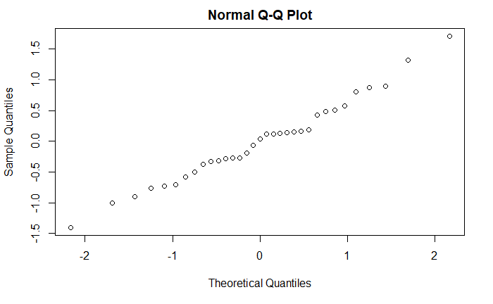
Assumptions
Normality

Slide 6
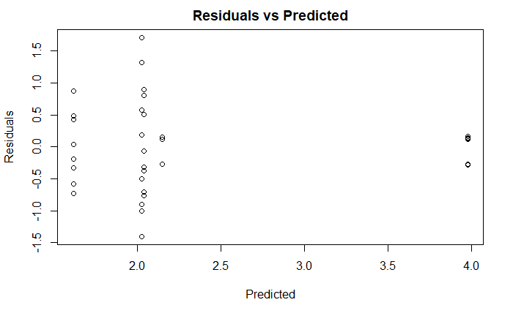
Assumptions (cont.’d)
Constant Variance

Slide 7
One Way ANOVA for Plant Species
After the assumptions were checked, ANOVA was conducted on the model, which resulted in:
Source Df Sum Sq Mean Sq F value Pr(>F) plant 4 21.82 5.454 10.42 2.68e-05 Residuals 28 14.65 0.523
Reject the Null Hypothesis; means are significantly different.
Tukey-Cramer (Multiple Comparisons):
No Plant-A. gerardii 0.0000153
No Plant-M. officionalis 0.0002553 P. coloratum-No Plant 0.0002818 T. aestivum-No Plant 0.0104951
When there was No Plant grown in the pot, the mean difference (vs pots with grown plant species) in pyrene concentration, was significant.

Slide 8

Unbalanced Design with Two Factors
The model to the test the both species and soil effects on the residual of pyrene in the soil, is:
$y_{ij}=μ+τ_{i}+β_{j}+{\left(τβ\right)}_{ij}+e_{ij}$
where $μ$= overall mean of pyrene concentration common to all plant species
$τ_{i}$= the effect of the plant species
$β_{j}$ = the effect of the soil type
${\left(τβ\right)}_{ij}$= the effect of the interaction between plant species and soil type
$e_{ij}$= the random error

Slide 9
The Dataset
Soil 1 | Soil 2
Plant Species | 1 | 2 | 3 | 4 | 5 | 6 | 7 | 8
A.gerardii | 2.44 | 2.81 | 3.62 | 4.16 | 8.15 | 5.23 | 12.09 | 7.75
P. coloratum | 3.8 | 3.58 | 5.63 | 5.31 | 7.25 | 12.75 | 17.25 | 18.91
M. officionalis | 3.10 | 1.87 | 4.59 | 2.77 | 9.15 | 28.37 | 13.57 | 42.09
T. aestivum | 6.51 | 9.65 | 10.03

Slide 10
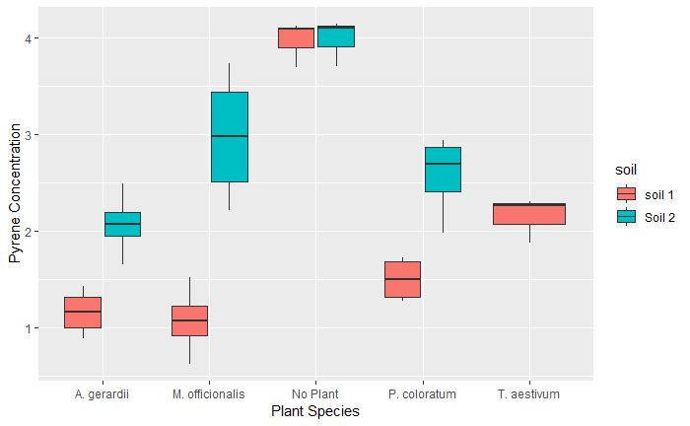
Graphical Observations
M.officionalis has the highest mean and variance pyrene concentration when grown with soil type 2, for pots with a plant grown in them
The mean pyrene concentration for the 4 plant types is similar when grown with soil type 1, except for T. aestivum
T.aestivum was not grown with soil type 2
Soil Type 1 appears to be more effective than soil type 2
Not growing a plant in the pot is not effective

Slide 11
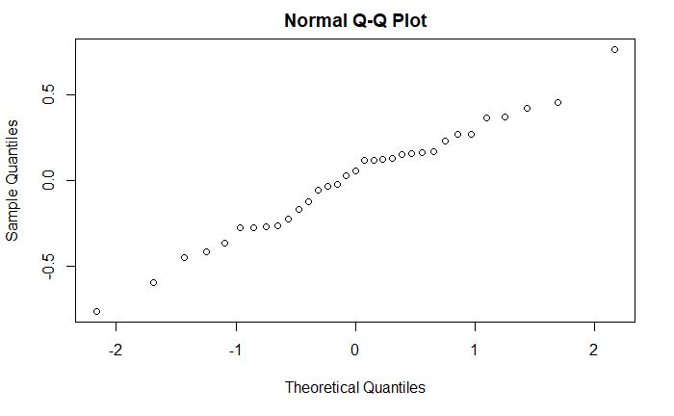
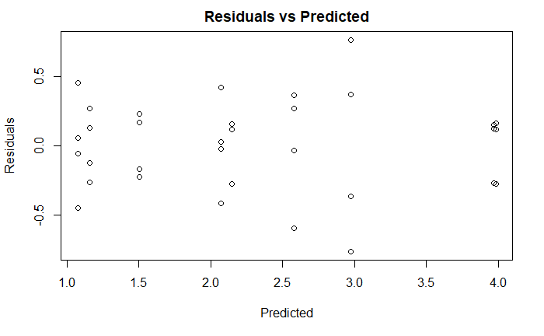
Assumptions
Both of the assumptions appear to be satisfied
Most of the points lie along the line on QQ Plot
The residual vs predicted values have a random spread; there are no obvious patterns

Slide 12
Two-Way ANOVA with Interaction
Type III ANOVA
Response: log(y) Sum Sq Df F values Pr(>F) x1 18.5317 4 32.3532 2.39e-09 *** x2 1.6694 1 11.6580 0.002276 ** x1:x2 3.0928 3 7.1992 0.001305 **
Since the p-value for the interaction is significant, reject the Null Hypothesis and conclude that the interaction is significan
Since there is a significant interaction, then a Type III ANOVA is a more powerful test than a Type II ANOVA

Slide 13
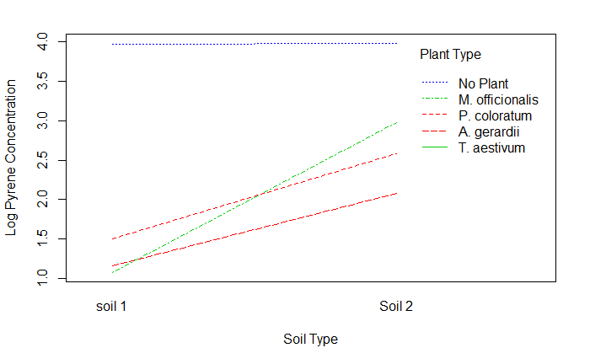
Interaction Plot
There appears to be significant interaction between M.officionalis and P. coloratum and A. gerardii

Slide 14
Findings
The interaction between plant species and soil type was statistically significant
Plant species (No Plant included) produced statistically significant mean pyrene concentration
M. officionalis had signiciant interaction with two other plant types

